Slide 1
Equitable Services to Independent Schools
March 8, 2021

Slide 2
Topics
Background
Who’s Eligible?
Outreach
Determining Amounts
Consultation
Providing Services
Questions

Slide 3
Background

Slide 4
Background
Federal law allows federal education aid to be provided to children in need, regardless of whether they attend a public or eligible independent school.
The Elementary and Secondary Education Act (ESEA / ESSA) requires that eligible independent schools be invited to participate in Titles I, II, III and IV, coordinated by LEAs
ESSA Sec. 1117 / ESSA Sec. 8501

Slide 5
Background
Essentially, LEAs that receive CFP funds are obligated to facilitate the participation of eligible independent schools in these funds.

Slide 6
Who’s Eligible?

Slide 7
Who’s Eligible?
Non-profit, approved or recognized independent elementary and secondary schools, including those that are religiously-affiliated.
Standalone independent Pre-Ks are not eligible. However, in eligible elementary and secondary schools that include Pre-Ks, these students and staff members can be served
An updated list of eligible schools was sent in February and can be found here

Slide 8
Who’s Eligible (for which funds)?
Non-profit, approved/recognized schools within the LEA’s boundaries: Titles I*, II, III, IV
Non-profit, approved/recognized schools beyond the LEA’s boundaries: Title I*

Slide 9
*Who’s Eligible: The Complicated Case of Title I
Independent schools eligible to participate in Title I are schools that
Are non-profit, approved/recognized AND
Enroll students who are
Residents of a Title I-served catchment area within the LEA—in other words, would have attended a public Title I school AND
From households that are low-income

Slide 10
*Who’s Eligible: The Complicated Case of Title I
Title I funds “follow” students who meet both criteria, including to eligible independents outside of the LEA.
This means that an eligible independent school may receive Title I funds from multiple LEA.

Slide 11
Who’s Eligible: Do Title I funds “follow” her?
A fourth grader who lives in Coolidge SD attends Lakeview Christian Academy, a non-profit independent school in a neighboring LEA.
The student’s household is not low-income, but she resides in the attendance area of a Title I-served elementary school. No.
The student’s household is low-income, but she resides in the attendance are of a non-Title I elementary school. No.
The student’s household is low-income, and she resides in the attendance area of a Title I elementary school. Yes.

Slide 12
Outreach

Slide 13
Outreach
Outreach to eligible independent schools should occur in the late winter or spring, before initial CFP applications for the coming fiscal year are submitted.
Outreach is the responsibility of the LEA, however…
Identifying schools outside of the LEA’s boundaries that are eligible for Title I participation can be challenging.
Independent schools are being encouraged to contact LEAs if they have not been invited to participate in Title I and believe that they enroll student who drive funds.

Slide 14
Outreach
The initial communication typically includes
An invitation to participate in funds in the coming fiscal year
A brief description of funds that the independent school is eligible to participate in
For schools within the LEA, Titles I (if enrolling qualifying students), II, III (if applicable), and IV
For schools beyond the LEA, Title I (if enrolling qualifying students)
An “Intent to Participate” section
A reasonable deadline for response

Slide 15
Outreach
I will share a letter template
Outreach attempts to eligible schools should be documented
Some LEAs use certified letters, though date-stamped emails are also common

Slide 16
Determining Amounts: Title II and Title IV

Slide 17
Determining Amounts: Title II and Title IV
Remember, only eligible independent schools within the boundaries of the LEA are eligible to take part in Titles II and IV.
The amounts of Title II or Title IV funds available for equitable service to independent schools are based on total enrollment. Low-income status and residence are not considered.

Slide 18
Determining Amounts: Title II and Title IV
The LEA determines the total enrollment of public schools & total enrollment of participating independent schools within the boundaries of the LEA. LEAs and independent school officials should come to agreements on acceptable, accurate enrollment numbers during outreach and consultation.
These proportions are applied to the LEA’s annual IIA or IVA allocation (not including carryforward) to determine the total equitable services set-aside amount.

Slide 19
Determining Amounts: Title II/IV in GMS
“Equitable Share” Tab / “Title IIA (or Title IVA) Participation” Sub-Tab

Slide 20
Determining Amounts: Title II/IV in GMS
“Equitable Share” Tab / “Amounts by School” Sub-Tab
-LEAs break down total amount by hand, proportionally

Slide 21
Determining Amounts: Title III

Slide 22
Determining Amounts: Title III*
The LEA determines the number of ELs in public schools & number of ELs in participating independent schools within the physical boundaries of the LEA. Residence and household income are not considerations.
These proportions are applied to the total IIIA allocation to determine the equitable services set-aside amount

Slide 23
Determining Amounts: Title III in GMS
“Equitable Share” Tab / “Title IIIA Participation” Sub-Tab

Slide 24
Determining Amounts: Title I

Slide 25
Determining Amounts: Title I
Remember, independent schools both within and beyond the boundaries of the LEA may be eligible to take part in Title I
Total amount of Title I funds available for equitable service to independent schools is based on the number of students who are
Residents of a Title I-served catchment area within the LEA
From households that are low-income

Slide 26
Determining Amounts: Title I
The LEA determines its attendance areas (schools) that will participate in Title I in the coming year.
The LEA determines the number of children from low-income households residing in these attendance areas who attend public schools, and the number who attend independent schools. Need to work with independent schools to determine.
The LEA applies these proportions to the annual Title I allocation (not including carryforward) to determine the total set-aside amount

Slide 27
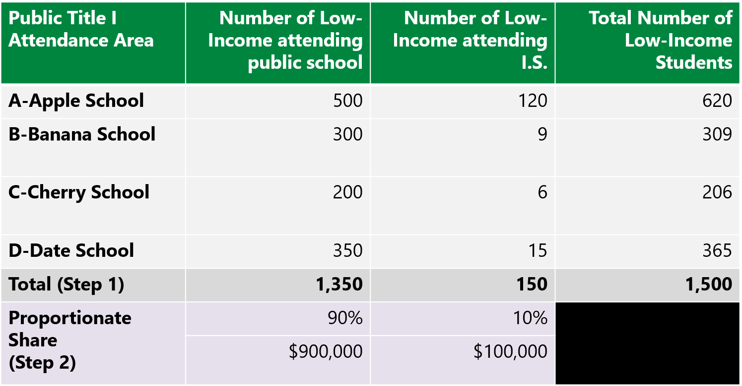
Title I Example

Slide 28
Determining Amounts: Title I in GMS
Targeting and Ranking, Step 1A:

Slide 29
Consultation

Slide 30
Consultation
Collaboration with eligible, interested independent schools in order to design and develop the equitable services program
Must be timely and meaningful

Slide 31
What is Timely?
Before the LEA makes any decisions about reserving, transferring or consolidating funds.
Before the LEA makes any decisions about activities and opportunities for independent schools to participate

Slide 32
What is Meaningful?
Genuine opportunity for all parties to express their views, and all views seriously considered.
The LEA may initiate consultation with a proposal for services.
Final decisions made by the LEA after consultation.

Slide 33
Consultation Topics
How the needs of eligible private school students and staff have been identified
What services the LEA will offer to eligible students and staff
How, where, when and by whom the services will be provided
How the efficacy of services will be assessed and how the results will be used to improve services

Slide 34
Consultation Topics: Title I
Title I: How many independent school students reside in an LEA attendance area that is served by Title I? Need addresses.
Title I: Of these students, which are from low-income families?
Use the same low-income measure that the LEA uses (typically FRL); or
Use comparable poverty data from a different source, such as a tuition assistance, parent income survey, etc.; or
Use Proportionality. Assume that independent school students who reside in a Title I-served attendance area experience the same rate of poverty as public-school students.
For example, if Public School A has a low-income rate of 40%, assume that 40% of independent school students who reside in Public School A’s attendance area are from low-income households.

Slide 35
Consultation: Documentation
Written, signed affirmation of consultation with each eligible independent school within and beyond the boundaries of the LEA
OR written, signed affirmation of an Independent School choosing not to participate
OR documentation of attempts to contact/consult
Beginning this year, LEAs must use the AOE form to document the results of outreach and consultation. These forms will be collected by the AOE annually.

Slide 36
Providing Services

Slide 37
Providing Services
Activities are written into the CFP application, just like investments for the LEA’s public schools, and are budgeted accordingly.
Activities must meet same standards of allowable, reasonable, necessary, allocable and supplemental.

Slide 38
Services: Control of Funds
The LEA controls all funds, title to materials, equipment, and property purchased. Independent schools receive services, not funds, and have no authority to spend. Reimbursement is not allowed.
The LEA plans, designs, and implements program (including procurement, ordering, payments, etc)—this can not be delegated to the independent school.

Slide 39
Services: Personnel
Personnel services (interventionists, coaching, counseling, etc) must be provided by an employee of the district or a 3rd party contractor.
Services for private school children should begin at the same time as services for public school children.

Slide 40
Services: Equipment and Supplies
The LEA may place equipment and supplies in a private school for the period of time needed for the program, and only for the program.
LEA should take biannual inventory of equipment and supplies placed in independent schools. Use, management and disposition of equipment and supplies should follow Uniform Grants Guidance §200.313 (“Equipment”).
Materials must be neutral, secular, and non-ideological

Slide 41
Services: Professional Development
LEA may pay stipends directly to independent school teachers for participation in PD activities.
LEA may not pay for independent school substitute teachers.
Must be neutral, secular and non-ideological, at least the portion funded by the grant

Slide 42
Services: Obligation of Funds
Funds allocated to an LEA for educational services and other benefits to eligible independent schools must be obligated in the fiscal year for which the funds are received by the LEA.
There may be extenuating circumstances, however, in which an LEA is unable to obligate all funds within this timeframe.
Under these circumstances, the funds may remain available for the provision of equitable services during the subsequent school year.

Slide 43
Services: Title I
Independent Schools that participate in Title I must operate as a Targeted Assistance school—need to identify a “caseload”
Students who reside in participating public school attendance areas (i.e., the area of a Title I Part A School); and
Are identified as eligible through multiple, educationally-related criteria.
As with public Title I schools, low-income status is what drives funds to the independent school—it is not the criteria for determining which students to serve.

Slide 44
Services: Title I
LEA of residence is responsible for providing Title I services for its eligible students, even if the students attend an independent school in another LEA.
Resident LEA may reimburse a “lead” LEA to provide services on its behalf, typically the LEA in which the school is located. This lead LEA may conduct consultation and write investments on behalf of other LEAs, if the independent school is in agreement

Slide 45
Questions
Do I have to conduct outreach concerning Title I participation to non-profit independent schools across state lines? Yes.
Do I have to conduct outreach concerning equitable participation to non-profit independent schools in which students are placed by the LEA, including students eligible for special education? Yes.
My LEA does not operate a high school—do Title I funds still “follow” our high school-aged students to eligible independent schools both within and outside of the LEA? No. These students do not meet the criteria of residing in the attendance area of a public Title I-served school.

Slide 46
Ombudsman
Serve as the primary point of contact for addressing questions and concerns from independent school officials and LEAs regarding the provision of equitable services
Monitor and ensure the equitable services requirements
Jesse Roy | jesse.roy@vermont.gov | (802) 828-1390

