Slide 1
Submission Updates: CIPs and CFP Applications
Josh Souliere / Jesse Roy
January 29, 2020

Slide 2
Topics
The Data Inventory Tool
Format and Content
Upload in GMS
Rationale
CIP Template
Upload in GMS
Checklist/Review Process
Timeline

Slide 3
The Data Inventory Tool
The Data Inventory Tool…
Summarizes the data collection, initial analyses and findings used to initiate an LEA or school’s Continuous Improvement Planning process and to provide justification and purpose for CFP investments
Must be completed and submitted annually for both LEAs and schools, along with their CIPs.

Slide 4
The Data Inventory Tool

Slide 5
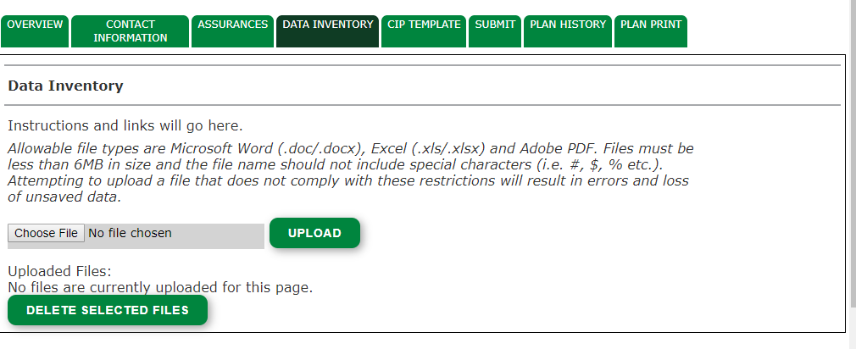
Data Inventory Upload Tab

Slide 6
The Data Inventory Tool: CFP Rationale
CNA and formal plan development are requirements for federal fund use throughout the Every Student Succeeds Act
Supports writing of high-quality investment, with statements of purpose clearly aligned to specific findings of data analyses:
Ex: “In order to improve informational text comprehension…”
Ex: “In order to decrease behavior referrals in non-classroom settings…”

Slide 7
The Data Inventory Tool: CFP Rationale
Provides a secondary opportunity, supplemental to the CIP, to explore needs specific to the intents of Title funds
Enables a more stringent application review by the CFP Team
Q: Do specific investment strategies need to be described in the Inventory?
A: No, but strategies should be clearly supported by specific data and findings.

Slide 8
The Data Inventory Tool: CIP Rationale
Development of your CIP through completing a CNA is a required component of continuous improvement planning
Goals and change ideas should be data driven and aligned with your CNA
The data inventory organizes the data and rationale you use to drive your goals and change ideas

Slide 9
CIP Template: Content and Upload
Template must be uploaded into GMS.
You can still access all past CIPs in GMS.
All sections of the CIP template must be completed
SU/SD and School CIPs can have the same goals, but school CIPs must have change ideas specific to their prioritized needs (determined through the CNA process) and capacity to implement. Exact copies or replicas of the SU/SD CIP will not be accepted for school level CIPs.

Slide 10
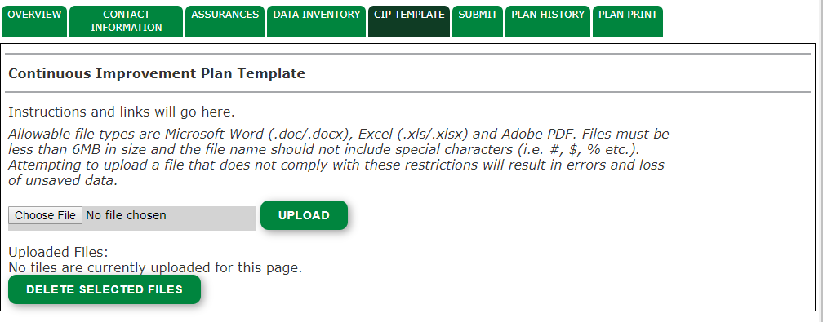
CIP Upload Tab

Slide 11
CIP Template: Expectations and Review
Continuous Improvement Plan Review Process
Review process the Education Quality Coordinators (EQC) will be using when reviewing CIPs
Provides information EQCs will be looking for, and why CIPs could be returned
Aligned with the CIP Template

Slide 12
Timeline
CIP and Data Inventory submission begins on February 15.
While there is no deadline for submission, CIPs submitted by March 15 will be reviewed by the EQA team in advance of the April 1 opening of the CFP application.
CFP applications should be submitted by June 30 to be considered substantially approved for the July 1 start of the fiscal year.
While CFP applications can be drafted in advance of CIP approval, the CFP team will not review applications without approved LEA and school-level CIPs.

Slide 13
Questions?

